Slide 1
HR Anticipa AI
Retaining Talent through Transparent & Equitable AI
Turning the "Black Box" of turnover into a "Glass Box" for HR managers—illuminating the path to employee retention with ethical, explainable artificial intelligence.
Group 5
Notes:
1

Slide 2

The Challenge
What Keeps HR Leaders Awake
Rising resignation rates are draining resources—recruitment costs soar whilst invaluable institutional knowledge walks out the door. Sarah, our HR Director persona, faces mounting pressure to predict attrition before it happens. But she needs more than a list of names; she needs actionable insights she can trust and defend ethically.
Notes:
2

Slide 3
Our Solution: Technology Stack
01
02
GDPR-Cleaned Data Pipeline
Feature Engineering
Privacy-by-design approach with anonymisation of personally identifiable information
Derived metrics including tenure calculation and sentiment analysis scores
03
04
XGBoost Predictive Model
NLP Sentiment Analysis
Optimised tabular learning with SHAP explainability built-in
Processing performance review notes to extract NLP_Sentiment_Score
Our approach balances predictive power with computational frugality—choosing targeted NLP enhancement over resource-heavy LLMs, ensuring sustainability and accessibility.
Notes:
3

Slide 4
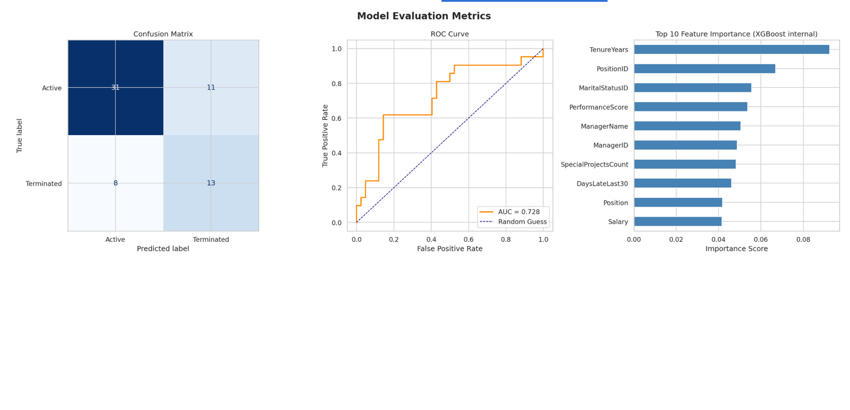
Model performance
Notes:
3

Slide 5
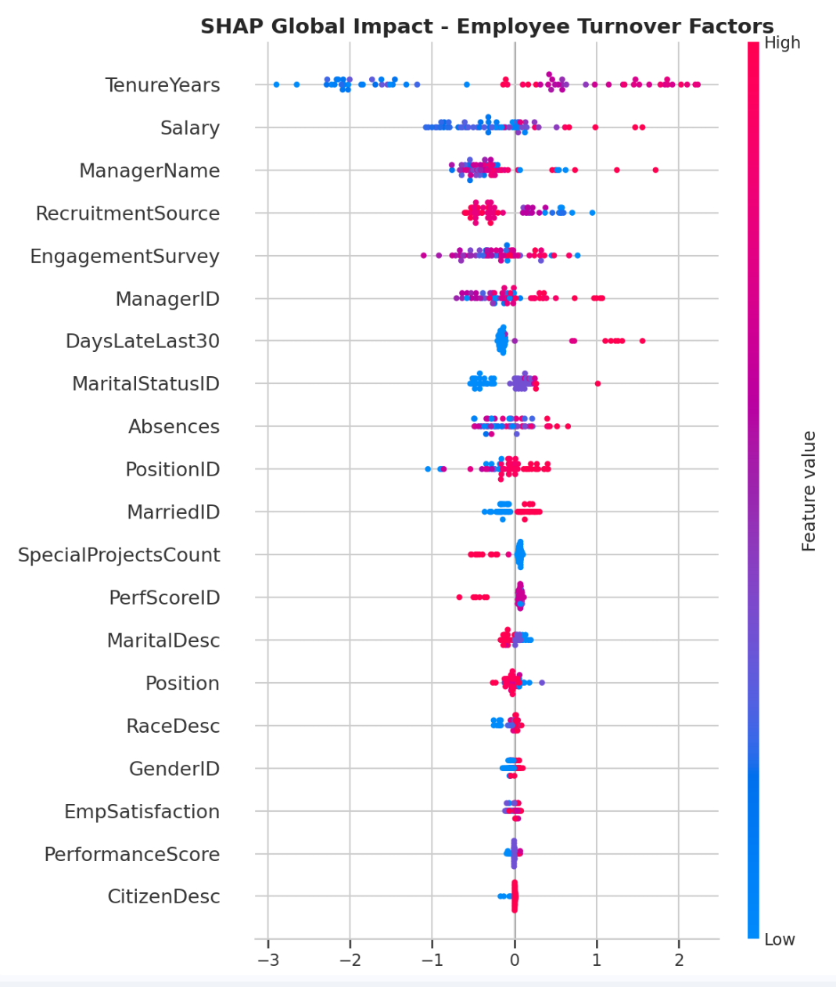


Pillar 1: Explainable AI
Global Feature Importance
Using SHAP (Shapley Additive Explanations), we rank company-wide turnover drivers. The top five influencers—tenure, salary, manager relationship, sentiment score, and role satisfaction—provide strategic direction for organisational interventions.
Key Insight: Understanding what drives turnover across the organisation enables proactive policy adjustments rather than reactive firefighting.
Notes:
4

Slide 6
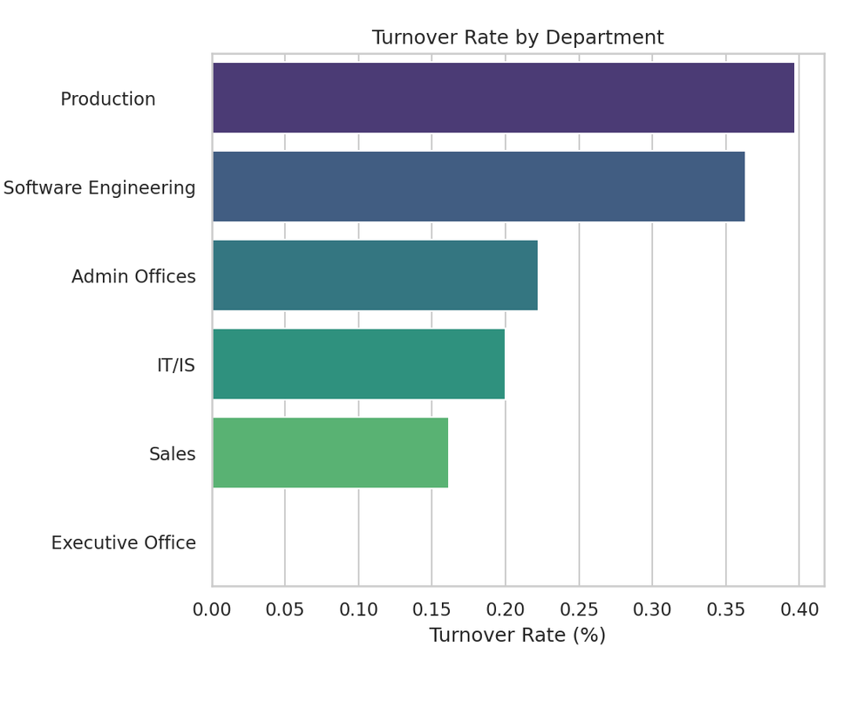
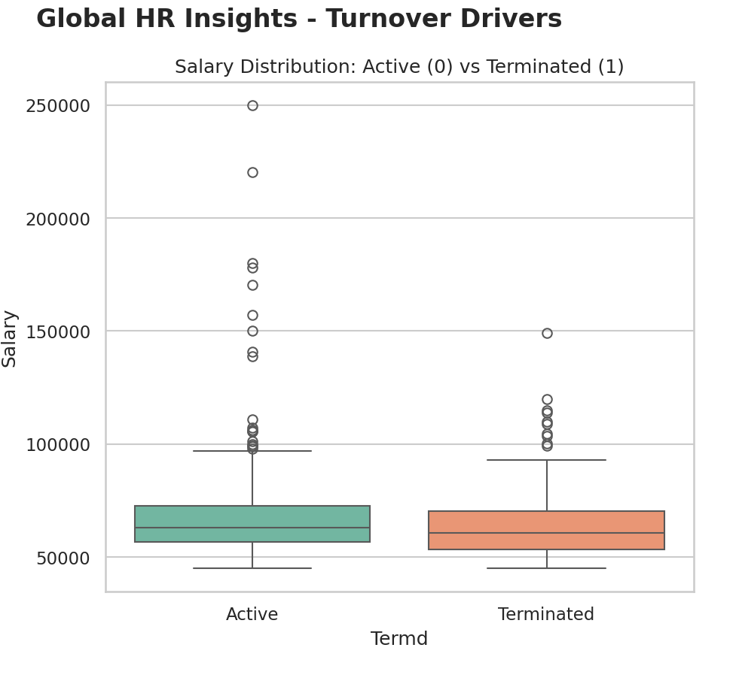
Local Explanations in Action
Real-Time Transparency
For each "at-risk" employee, the Waterfall plot reveals precisely why their risk score is elevated. For example, "Risk increased by low sentiment score" flags review language concerns.
This granularity empowers HR managers to engage employees with specific, evidence-based support—transforming prediction into personalised retention strategy.
Notes:
5

Slide 7


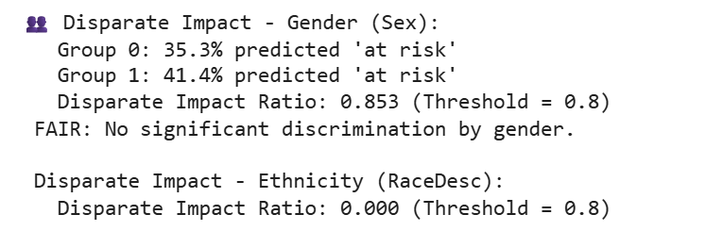
Pillar 2: Ethical AI
Bias Audit & Fairness Testing
1
2
Disparate Impact Ratio
Gender Parity Check
3
Ethnicity Analysis
Verification that model treats all ethnic groups equitably
Our Philosophy: We audited the model to ensure it predicts based on professional merit, not protected attributes. Fairness isn't an afterthought—it's engineered from the start.
Notes:
6

Slide 8



Compliance & Responsibility
GDPR-Compliant
Computational Frugality
Human-in-the-Loop
Anonymisation of names, dates of birth, and employee IDs ensures privacy-by-design from data ingestion through to model predictions
SHAP explanations ensure HR managers have final authority and can override AI recommendations—technology assists, humans decide
Optimised tabular model (XGBoost) delivers predictive power without resource-heavy LLM infrastructure—sustainable and accessible
Notes:
7

Slide 9



Impact & Next Steps
Lower Turnover
Higher Morale
Strategic HR
Predictive insights enable proactive retention before resignation
Data-driven support demonstrates organisational commitment to employees
Transparency builds trust in AI-assisted decision-making
Pilot Programme
Launch in highest-turnover departments to validate predictive accuracy and measure retention impact over six months.
Notes:
8

